Slide 1
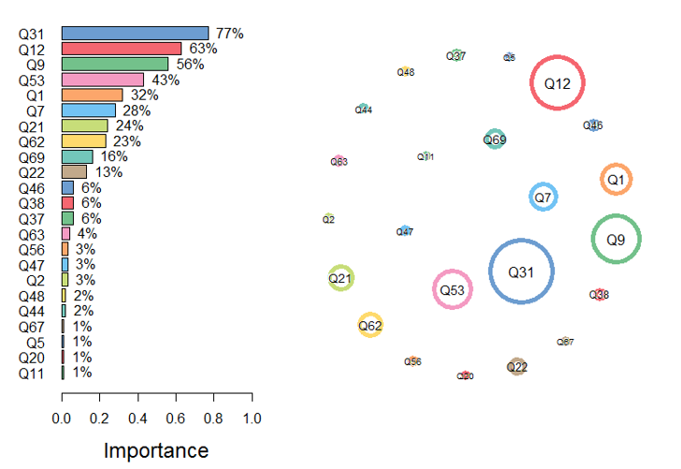
What determines who wants earn >200 K?
--Question Importance Analysis
Top 5 most Important Questions
Q31: How many countries have you visited?
Q12: What is your current gross income?
Q9: How long do you spend reading extra.?
Q53: How much do you weigh?
Q1: How many years of prof. experience?

Slide 2
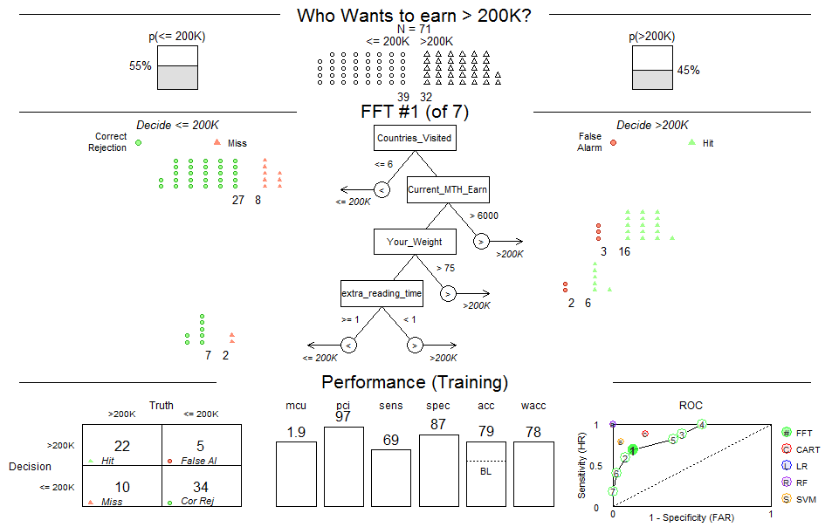
What determines who wants earn >200 K?
--Decision Tree and Performance Statistics

Slide 3
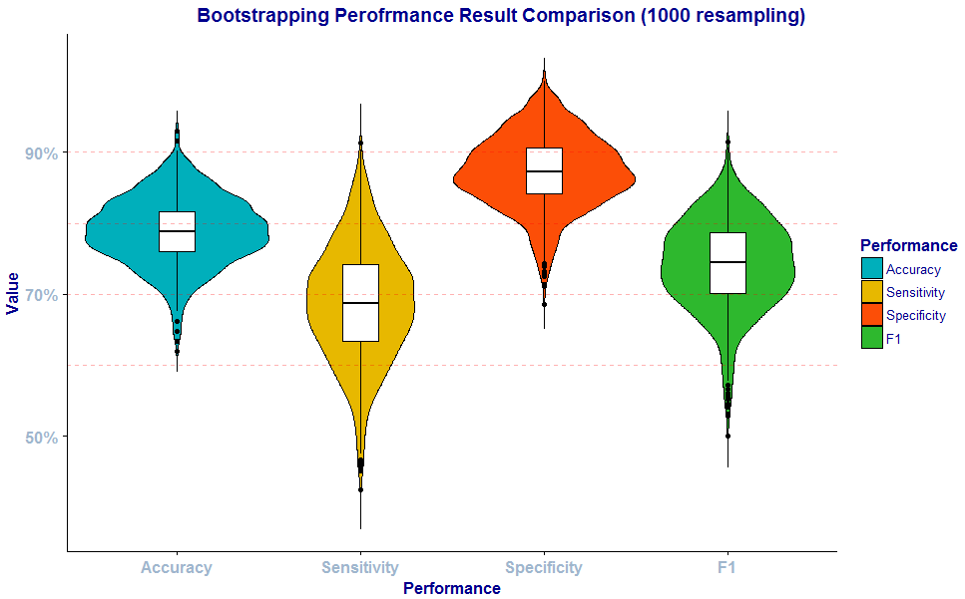
How accurate is the model?
--Model Verification with Bootstrapping

Slide 4
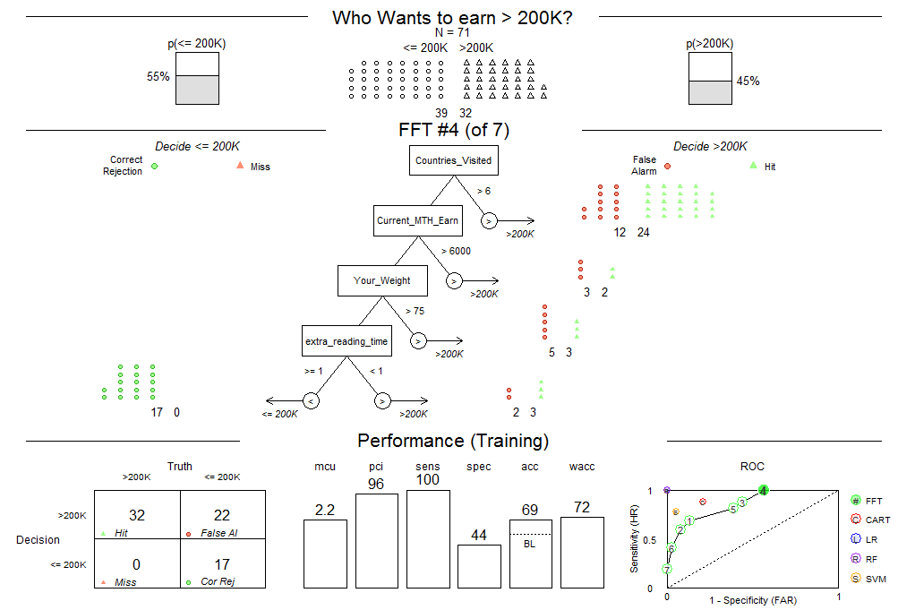
How about make sensitivity 100%?
--We would like to know who were less ambitious ☺

